Slide 1
Noman Sharif(4390)
BA Boot Camp Intern

Slide 2
Outlines
Formal Definition
Types
History
Laws
Religions
Cases
Conclusion

Slide 3

Euthanasia
Meaning:
Greek Words “Eu” means “Good”
and “Thanatosis” means “Death”.
Formal Definition:
“The practice of ending the life of
a patient to limit the patient's suffering.”

Slide 4

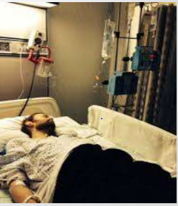

Types of Euthanasia
Active
Passive
Voluntary
Involuntary
Assisted
Indirected

Slide 5
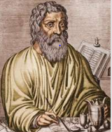
History
Euthanasia started in ancient Greece and Rome around the fifth century B.C.
Hippocratic Oath: “I will give no deadly medicine to any one if asked, nor suggest any such counsel”.
Slippery Slope Theory: “The general public fear
that if active voluntary euthanasia is legalized, the
strict protocol will be breached by physicians across
the country”

Slide 6
During the Middle Ages | Euthanasia was pretty much out of the question
During the Seventeenth and Eighteenth centuries | Euthanasia was a topic of discussion. However, people continued to reject euthanasia and assisted suicide.
1478-1535 | Sir Thomas More the first prominent Christian to recommend euthanasia in his book Utopia, where the Utopian priests encourage euthanasia when a patient was terminally ill and suffering pain
1828 | The first law against assisted killing, known as anti-euthanasia was passed in new york.

Slide 7
1870 | The use of morphine and analgesic medications for assisting quick and painless death was suggested.
1885 | The American Medical Association strongly denied the use of analgesic for euthanasia.
1994 | Netherlands it is the first country where euthanasia has been allowed.
2001 | The euthanasia law was adopted in Belgium - this law defines conditions for doctors to avoid penal punishment.
2008 | U.S. state of Washington legalizes assisted suicide

Slide 8
Laws
In Europe, Euthanasia is only legal in the Netherlands and Belgium, provided certain conditions are met.
In Belgium euthanasia is only allowed if the patient is an adult.
However, in the Netherlands euthanasia is allowed for children aged between 12 and 16 years of age, with the consent of their parents/guardians and for individuals aged 16 years and over.

Slide 9
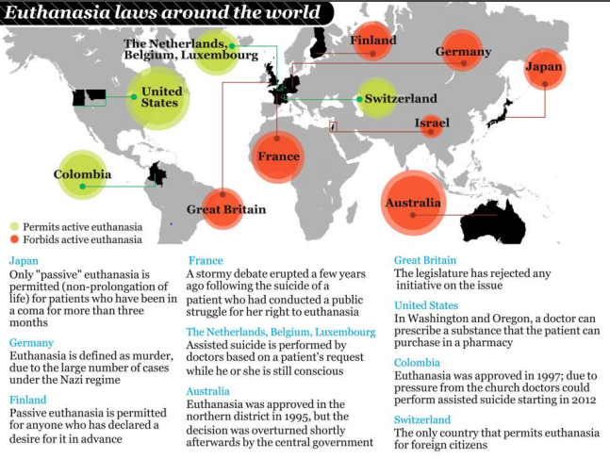
In Japan : Only " passive " euthanasia is
permitted for patients who have been in a
Coma for more than 3 months
While in Egypt , or in Islamic countries
in general , the popular Egyptians' Scholar
Sheikh , recently issued a fatwa . Equating
euthanasia with murder but allowing the
with-holding of treatment that is deemed
useless.

Slide 10
Religion
Most religions disapprove of euthanasia for a number of reasons:
God has forbidden it ( that says 'you must not kill').
Human life is sacred.
Human beings are made in God's image.
God gives people life, so only God has the right to take it away

Slide 11


Religious views on Euthanasia:
Islam:
Muslims are against euthanasia.
They believe that all human life is sacred because it is given by Allah, and that Allah chooses how long each person will live.
Shinto:
In Japan, where the dominant religion is Shinto, 69% of the religious organizations agree with the act of voluntary passive euthanasia.
In Shinto, the prolongation of life using artificial means is a disgraceful act against life.

Slide 12



Christianity:
Christians are mostly against euthanasia.
Life is a gift from God Christianity requires us to respect every human being.
While
Judaism and Buddhism:
Generally, Jewish thinkers oppose voluntary euthanasia, often vigorously, though there is some backing for voluntary passive euthanasia in limited circumstances.
• An important value of Buddhism teaching is compassion. Compassion is used by some Buddhists as a justification for euthanasia because the person suffering is relieved of pain.

Slide 13
Cases
Frank Van Den Bleeken
Craig Ewert
Frank Van Den Bleeken was a Belgian convicted of serial murder and rape who has been imprisoned for almost three decades. He was temporarily released and convict other brutal convictions.
• He sought the right to die because he was "suffering unbearably" from his psychiatric condition
• Unable to control his urges, the convict had no prospect of living in freedom.
• "He has clearly said that he didn't want to leave prison because he didn't want to risk creating further victims," he said. Seeing himself as a danger to society, he could "no longer live like that", his lawyer said.
• After doctors agreed that his psychological condition is incurable, Belgium's justice minister approved his transfer to a hospital where doctors will end his life on January 11, 2015.
• But on January 6, the justice minister announced that Van Den Bleekin’s “right to die” was withdrawn by his doctors. He was instead transferred to a psychiatric prison ward.
Craig Ewert 59, was a retired college professor who was diagnosed with motor neuron disease (MND), a neurodegenerative kind that affects the nervous system and could lead to difficulty in gripping, walking, swallowing, speaking and breathing.
• He decided to end his life rather than spend the rest of his life in a “living tomb” ,Since euthanasia is still illegal in Britain, he traveled to Switzerland to die assisted by the Diginitas clinic in Zurich in September 2006.
• He was already 5 months paralyzed prior to his televised death, his last moments was shown on the Sky Real Lives Channel live, he first said goodbye to his wife, drank the poison, asked for an apple juice, requested for Beethoven’s symphony no.9, said thank you, and died peacefully.

Slide 14
Conclusion
It is acceptable, as long as one’s decision will not cause harm to the rights of others.
Universality of euthanasia will reduce the burden on healthcare resources.
The legalization of euthanasia and assisted suicide would prevent the suffering and trauma of patients through the last stages of their life
Constitutionally the right to autonomy is respected elsewhere; it should be respected medically as well.

Slide 15
Thank You

